Slide 1
Electrochemistry Intro Review
Week of 11/19/18
Geoff Geberth

Slide 3
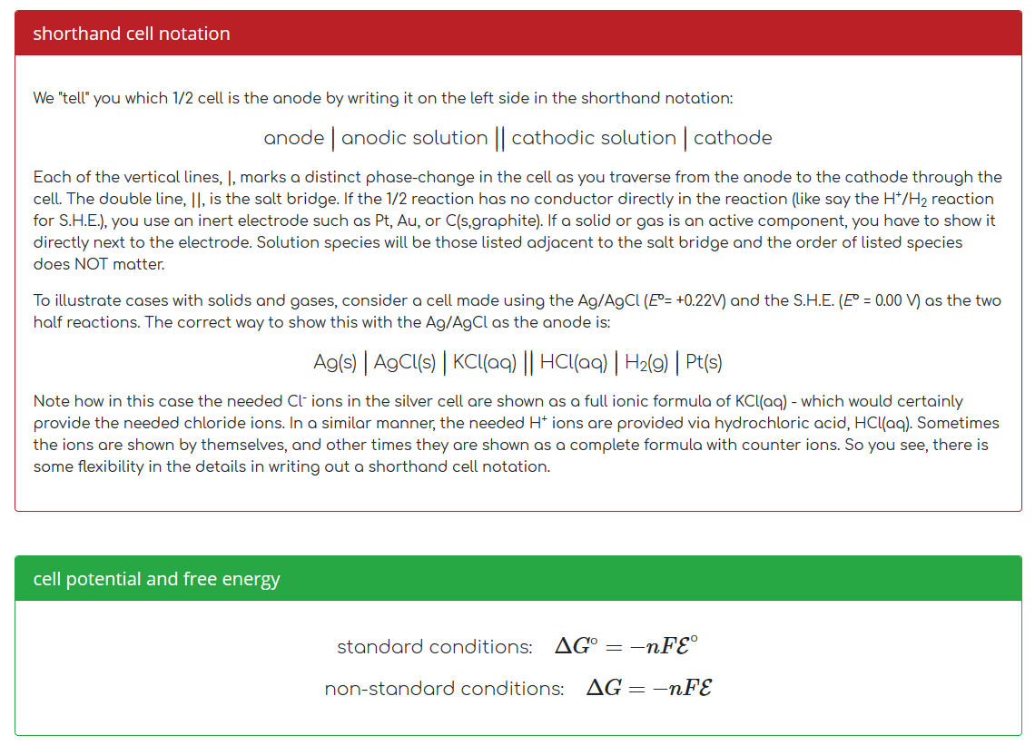

Slide 4
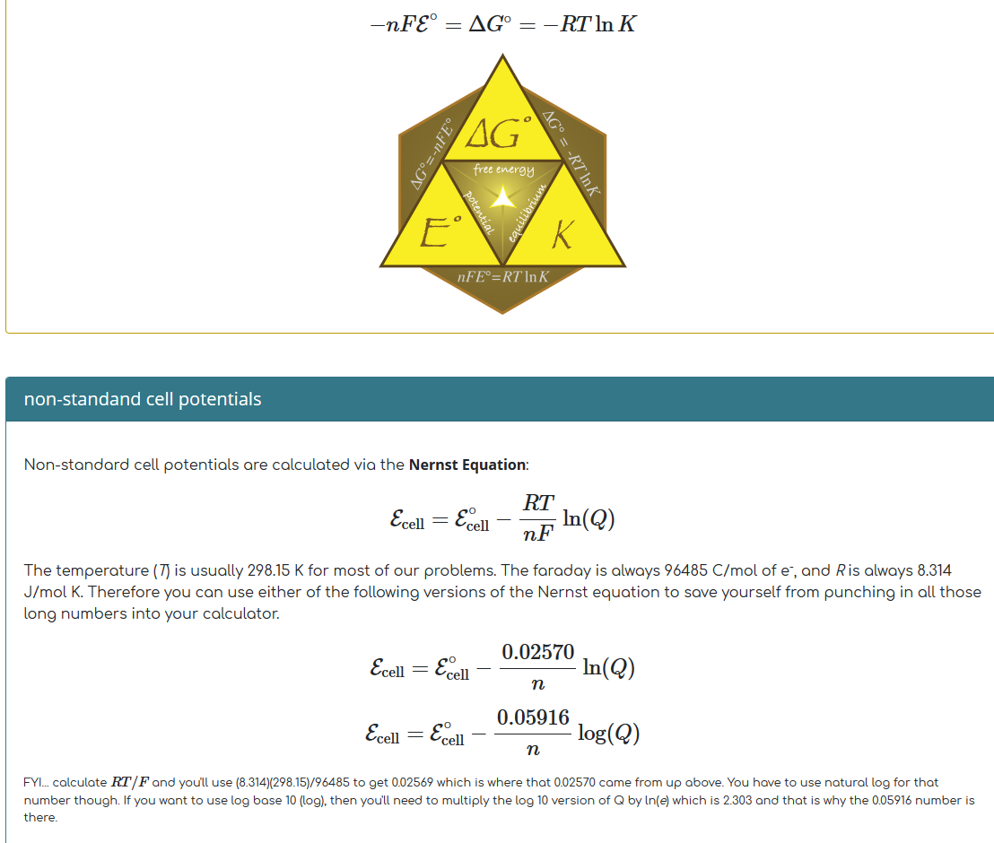

Slide 7
A shocking amount to know

Slide 8
REDOX Chemistry
The main force behind electrochemistry
Oxidation
Loss of electrons from a species (gets more positively charged)
Reduction
Gain of electrons from a species (gets less positively/more negatively charged)
OIL RIG
Oxidation Is Loss; Reduction Is Gain
BOTH processes happen in a reaction.
You will have both an oxidation and a reduction
The electrons must go somewhere
This is how batteries work

Slide 9
Oxidation numbers
0 for all species in an elemental state
For a monatomic ion, Ox # = charge
Sum of all Ox #’s must equal the net charge of the species
In compounds, hydrogen is +1 unless bonded to a metal, in which case it is -1 (such as LiH)
The most electronegative element is assigned its charge as an ion (ex: in MgBr₂, Br = 1- and therefore Mg = 2+
Unless bonded to another oxygen in a peroxide, oxygen is -2.
It is -1 in a peroxide (H₂O₂)

Slide 10
Remember your electronegativity
Utilized from gchem

Slide 11
Let’s Practice!
$PO_{4}^{3−}$
O = -2; P = +5
${SO}_{4}^{2−}$
O = -2; S = +6
$FeCl_{3}$
Cl = -1; Fe = +3
${Al}_{2}{\left({SO}_{4}\right)}_{3}$
Al = +3 (see sulfate above)
${Na}_{2}SiF_{6}$
Na = +1; F = -1; Si = +4

Slide 12
Why do we care?
Use oxidation numbers to determine what gets oxidized or reduced in a reaction
Ex: $2Fe\left(s\right)+3O_{2}(g)→2{Fe}_{2}O_{3}(s)$
Oxygen takes a -2, so we have -6, therefore Iron becomes +3 to balance.
Iron is oxidized, oxygen (going from 0 to -2) is reduced
What are the two reactions we’re dealing with (ignoring stoichiometry)?
$Fe→{Fe}^{3+}+3e^{−}$
$O_{2}+2e^{−}→2O^{2−}$
These are called Half-reactions. They are important for balancing Redox equations

Slide 13
A bit of important nomenclature
The species that undergoes reduction is the oxidizing agent and by nature causes oxidation
The species that undergoes oxidation is the reducing agent and by nature causes reduction
In the previous reaction with iron and oxygen, what are the oxidizing a reducing agents?
Oxidizing agent = Oxygen (is reduced)
Reducing agent = Iron (is oxidized)

Slide 14
Balancing Redox reactions (the half-reaction method)(acidic conditions)
Identify your half reactions
For each half reaction, balance all elements EXCEPT hydrogen and oxygen
Balance the oxygens by adding H₂O
Balance the hydrogens by adding H⁺
Balance the total charge using electrons (e⁻)
Match the electron count for the two half-reactions by multiplying stoichiometric coefficients of the half-reactions
Combine the two reactions to make the overall, cancelling any species on both sides
Check your work to make sure you have the same components on both sides

Slide 15
Let’s practice
In the video game Rainbow 6 Siege, fictional operator Dominic Brunsmeier (codename Bandit) utilizes lead acid batteries in order to electrify surfaces. (RXN = $Pb\left(s\right)+PbO_{2}(s)→PbSO_{4}(s)$
$$Pb(0)\left(s\right)→Pb(+2)SO_{4}(s)$$ | $$Pb(+4)O_{2}\left(s\right)→Pb(+2){SO}_{4}$$
$$Pb\left(s\right)+SO_{4}^{2−}→PbSO_{4}(s)$$ | $$PbO_{2}\left(s\right)+SO_{4}^{2−}\left(aq\right)→Pb{SO}_{4}$$
 | $$PbO_{2}\left(s\right)+SO_{4}^{2−}\left(aq\right)→Pb{SO}_{4}+2H_{2}O$$
 | $$4H^{+}+PbO_{2}\left(s\right)+SO_{4}^{2−}\left(aq\right)→Pb{SO}_{4}+2H_{2}O$$
$$Pb\left(s\right)+SO_{4}^{2−}→PbSO_{4}\left(s\right)+2e^{−}$$ | 2$e^{−}+4H^{+}+PbO_{2}\left(s\right)+SO_{4}^{2−}\left(aq\right)→Pb{SO}_{4}+2H_{2}O$
Combine your balanced half reactions!
$$Pb\left(s\right)+SO_{4}^{2−}+2e^{−}+4H^{+}+PbO_{2}\left(s\right)+SO_{4}^{2−}\left(aq\right)→Pb{SO}_{4}+2H_{2}O+PbSO_{4}\left(s\right)+2e^{−}$$
$$Pb\left(s\right)+4H^{+}(aq)+PbO_{2}\left(s\right)+2SO_{4}^{2−}\left(aq\right)→Pb{SO}_{4}+2H_{2}O+PbSO_{4}\left(s\right)$$
$$Pb\left(s\right)++PbO_{2}\left(s\right)+2H_{2}SO_{4}\left(aq\right)→Pb{SO}_{4}+2H_{2}O+PbSO_{4}\left(s\right)$$
Far more importantly, lead acid batteries are what you find in standard (non-hybrid or electric) automobiles!

Slide 16
Basic conditions
First, balance under acidic conditions
Add the same number of OH⁻ ions to the side of the eqn with H⁺ so that the acid is neutralized into water
Add the same number of OH- to the other side of the reaction
On the side with both H+ and OH-, cross them out and replace with water (This is the switch from acidic to basic conditions)
Cancel any waters that appear on both sides of the equation
Double check the balance

Slide 17
Practice in base
Initial reaction: $MnO_{4}^{−}\left(aq\right)+IO_{3}^{−}\left(aq\right)→MnO_{2}\left(s\right)+{IO}_{4}^{−}(aq)$
Balanced in acid (Do this yourself as an exercise):
$2H^{+}\left(aq\right)+2MnO_{4}^{−}\left(aq\right)+3{IO}_{3}^{−}\left(aq\right)→H_{2}O\left(l\right)+2{MnO}_{2}\left(s\right)+3{IO}_{4}^{−}(aq)$
$2OH^{−}+2H^{+}\left(aq\right)+2MnO_{4}^{−}\left(aq\right)+3{IO}_{3}^{−}\left(aq\right)→H_{2}O\left(l\right)+2{MnO}_{2}\left(s\right)+3{IO}_{4}^{−}(aq)$
$2H_{2}O\left(l\right)+2MnO_{4}^{−}\left(aq\right)+3{IO}_{3}^{−}\left(aq\right)→H_{2}O\left(l\right)+2{MnO}_{2}\left(s\right)+3{IO}_{4}^{−}\left(aq\right)+2OH^{−}$
$H_{2}O\left(l\right)+2MnO_{4}^{−}\left(aq\right)+3{IO}_{3}^{−}\left(aq\right)→2{MnO}_{2}\left(s\right)+3{IO}_{4}^{−}\left(aq\right)+2OH^{−}$

